Slide 1
Lecture 1:
0. The Big Picture: Growth in Historical Perspective
Brad DeLong
Department of Economics and Blum Center, U.C. Berkeley; and WCEG
last revised: 2020-01-06
delong@econ.berkeley.edu
U.C. Berkeley Econ 135 Spring 2020
Original course by Melissa Dell (Harvard Econ 1342 <https://canvas.harvard.edu/courses/8254/assignments/syllabus>), revised by Brad DeLong
<https://github.com/braddelong/public-files/blob/master/econ-135-lecture-1.pptx>
<https://bcourses.berkeley.edu/courses/1487685>

Slide 2
no iClickers today…
the system seems to be confusing people…
&, unless we have another 50 people suddenly flood into the classroom, we won’t use them…

Slide 3
If you are not enrolled yet…
Either (a) enroll (and drop later if you wish) or (b) send me at delong@econ.berkeley.edu an email from your Berkeley email address with “Econ_135: Enrollment” as the subject line, so that I can get you on the books…

Slide 4
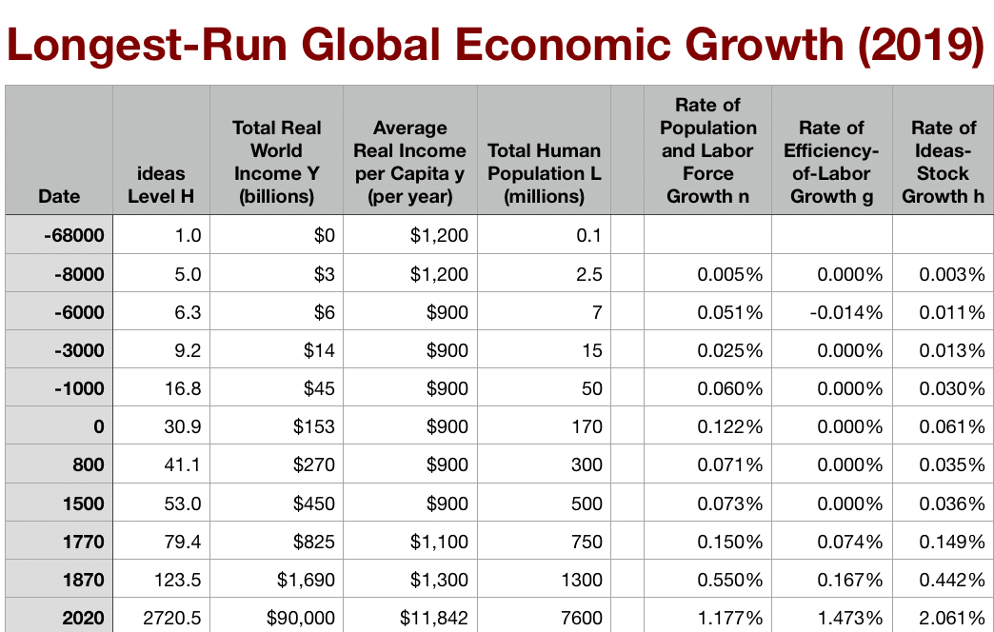
One Table: Average Global Numbers

Slide 5
To Your Clickers…
Approximately what was the growth rate of the human useful-ideas stock between the year 0 and 1500?
About 0.036%/year
About 3.6%/year
About 2.06%/year
About 0.206%/year
None of the above are close

Slide 6
How Should You Have Calculated the Answer?
What should you have had in the front of your minds? What in the back of your minds? What chain of reasoning should you have used?
31 to 53 over 1500 years = 0.036%
Rule of 72
2/3 of a doubling
(2/3) * 72/1500 = .05 * 2/3 = .033%/year

Slide 7

One Table: Average Global Numbers
Approximately what has been the growth rate of the human useful-ideas stock between the year 1870 and today?
About 0.036%/year
About 3.6%/year
About 2.06%/year
About 0.206%/year
None of the above are close

Slide 8
Why Is This Interesting?
2.06/.0036 is about 60, no?
What else do you find interesting about this table to the left?

Slide 9
One Table: Average Global Numbers

Slide 10
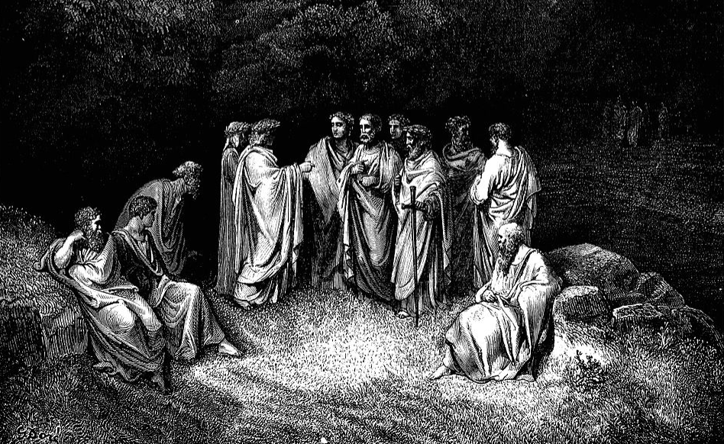
Change of Pace: Reading: Aristotle
THE TWENTY-FIVE MINUTE RULE!!
So stand up and stretch…
Say at least five awkward words to the person standing next to you…
Now we are going to talk about one of the pre-class readings…
<https://tinyurl.com/dl-2020-01-06b>
Dante and Virgil meet the past’s great thinkers in Hell’s Limbo
Gustave Dore
Dante Alighieri (1320): Inferno:
Poi ch'innalzai un poco più le ciglia,
vidi il maestro di color che sanno
seder tra filosofica famiglia.
Tutti lo miran, tutti onor li fanno.
Quivi vid' ïo Socrate e Platone,
Che 'nnanzi a li altri più presso li stanno…
When I had lifted up my brows a little,
The Master I beheld of those who know,
Sit with his philosophic family.
All gaze upon him, and all do him honour.
There I beheld both Socrates and Plato,
Who nearer him before the others stand…
J. Bradford DeLong brad.delong@gmail.com 2020-01-06

Slide 11
Pre-Class Reading: Aristotle
Pre-Class Readings:
Partha Dasgupta (2007): Economics: A Very Short Introduction, selections <https://delong.typepad.com/files/dasgupta-economics.pdf>
Aristotle: Politics, Book I <https://delong.typepad.com/files/aristotle-politics-book-i.pdf>
Dasgupta is for section.
Let’s look at Aristoteles son of Nikomachus of Stagira…
-384 Stagira to -322 Euboea
Lyceum, Peripatetic
THE Philosopher: “the Master… of those who know”
1650 years after his death, Aristotle’s is the most powerful intellectual name that Dante can conjure with
Deepest thinker, trying hard to get it right, most respected intellectual landmark for millennia
But you are going to hit Aristotle and think: “this is weird”—and a lot of it is weird, and even repugnant
Dante and Virgil meet the past’s great thinkers in Hell’s Limbo
Gustave Dore
Dante Alighieri (1320): Inferno:
Poi ch'innalzai un poco più le ciglia,
vidi il maestro di color che sanno
seder tra filosofica famiglia.
When I had lifted up my brows a little,
The Master I beheld of those who know,
Sit with his philosophic family.
All gaze upon him, and all do him honour.
There I beheld both Socrates and Plato,
Who nearer him before the others stand…
J. Bradford DeLong brad.delong@gmail.com 2020-01-06 https://tinyurl.com/dl-2020-01-06a https://tinyurl.com/dl-2020-01-06b

Slide 12
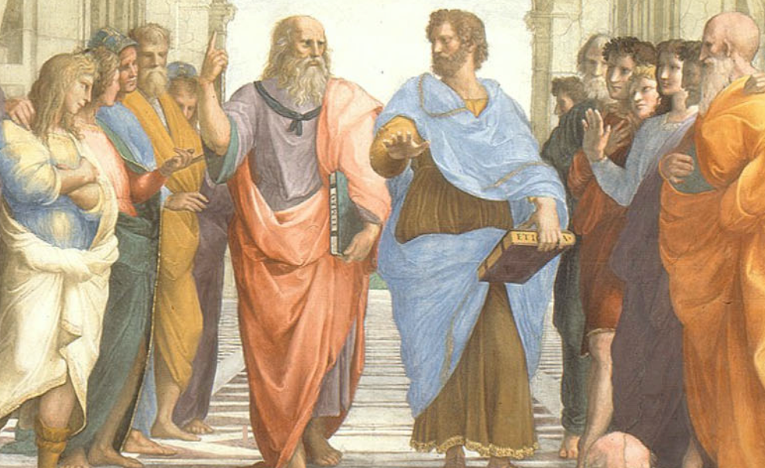
Nevertheless, We Read Aristotle…
For how could we learn if we only read people who we found not-weird?
A mighty, flawed thinker we can learn from:
His thought is mighty
Many have taken his thought—even where it is flawed—to be mighty
We have a lot to learn from him—even if often what we have to learn is not what he sets out to teach…
Note his (implicit and explicit) starting points…
Critically evaluate his arguments: where do we get off and where can we rejoin his trolley?
Plato and Aristotle in Conversation
Raphael: The School of Athens
J. Bradford DeLong brad.delong@gmail.com 2020-01-06

Slide 13
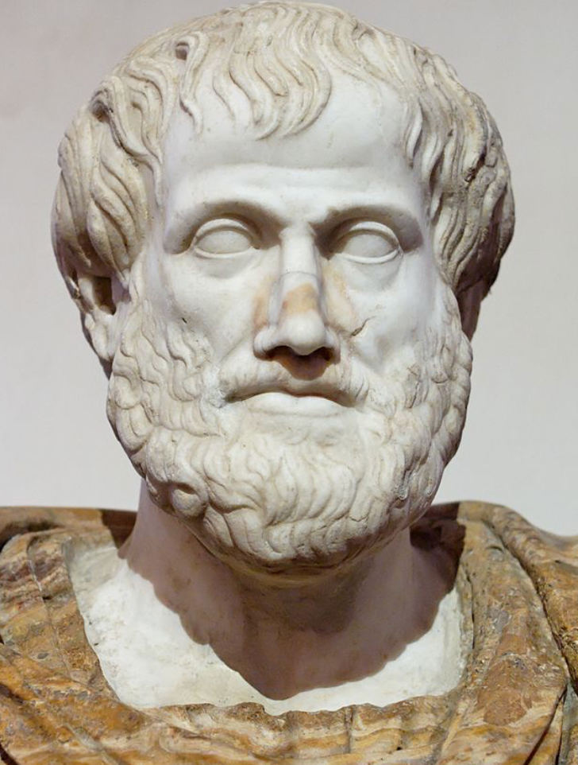
Aristotle: Politics
How Greek men order and ought to order their households and city-states:
For a Greek man to have a functional household, and for Greek men to have a functional city-state, they need resources
Politics Book I is what Aristotle believes people thinking about politics need to know about acquiring, maintaining, and managing resources
It is what Aristotle has to say about what we would call the economy
Aristotle
Roman marble copy of a Greek bronze by Lysippos (-330)
J. Bradford DeLong brad.delong@gmail.com 2020-01-06

Slide 14
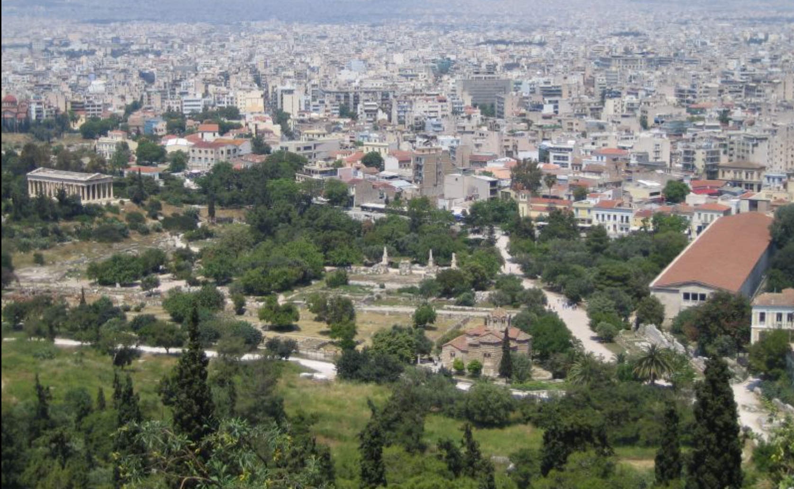
Aristotle on the Economy
But we don’t read Aristotle to learn about the economy:
Just as we would not read Aristotle to learn about physics, or chemistry, or astronomy
We read Aristotle to learn how intelligent ancient observers saw the economy
Taking their observation both as a social fact worth study in itself, and as a window into the pre-industrial economy.
The Agora of Classical Athens
Temple of Hephaistos in the upper left; Arcade (stoa) of King Attalos on the right
J. Bradford DeLong brad.delong@gmail.com 2020-01-06

Slide 15
Aristotle on Economic Growth
And we are interested in what Aristotle’s writings here tell us about economic growth
About what Aristotle’s thoughts are about economic growth
About the broader intellectual currents in which Aristotle was then swimming
About the economy in which he was embedded, and about its process of growth—or of not-growth
The Agora of Classical Athens
Temple of Hephaistos in the upper left; Arcade (stoa) of King Attalos on the right
J. Bradford DeLong brad.delong@gmail.com 2020-01-06

Slide 16
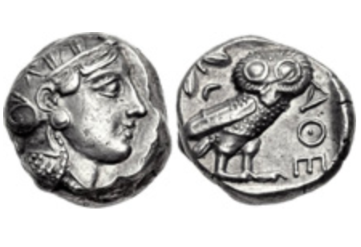
Questions
What assumption that Aristotle made—perhaps (probably?) without thinking about it, because it seemed most obvious to him—struck you as the most wrong or repugnant or weird?
What does Aristotle say are the four tasks of the Greek man in managing his household? Why these four?
What role do the “statues of Daedalus, [and] the tripods [robotic catering vessels] of Hephaestus” play in Aristotle’s argument about how the economy of his age is, must be, and should be structured?
What role does Aristotle’s claim that “Of the art of acquisition [ktêtike] then there is one kind which by nature is a part of the management of a household…. There is another… commonly and rightly called an art of wealth-getting [chrêmatistikê]… [with] the notion that riches and property have no limit…” play in his argument?
At the end of the first long paragraph of I.11, Aristotle writes: “Of the several divisions of wealth-getting I now speak generally; a minute consideration of them might be useful in practice, but it would be tiresome to dwell upon them at greater length now…” An alternative translation would say “detailed and exact discussion would be useful for the practical workings but to spend too much time on such things is crude…” (see Josiah Ober (2019): Agamemnon’s Cluelessness <https://delong.typepad.com/files/ober-agamemnon-1.pdf>). Aristotle considers knowledge of the art of wealth-getting “not unworthy of philosophy”, but spending your time practicing this art “illiberal an irksome”; philosophers should know how Thales of Miletos got rich by cornering the olive-press market on the island of Lesbos, but for Aristotle, his students, or his readers to dwell upon these matters at greater length would be “tiresome” or “crude”. What do you think is going on in Aristotle’s mind here?
Did you find any advice—even indirect and oblique advice—from Aristotle in this passage about what the economic policy of a city-state should be? If so, what was it? If not, why do you think he fails to offer advice here (he offers lots of advice as to the organization and policies of city-states later on in the book)?
Near the start of Book I Aristotle divided household management into four branches: (1) master-slave, (2) gender roles, (3) human reproduction, and acquiring material resources. he then skipped over (2) and (3) to talk about (1) and (4). Near the very end of the Book I, in I.12, he returns to (2) and (3). He says that “A husband and father, we saw, rules over wife and children, both free, but the rule differs, the rule over his children being a royal, over his wife a constitutional rule”. What is the distinction that you think Aristotle is drawing here? How important is it? (And do note that Aristoteles is here having an argument with Sokrates and Platon, who believed in gender equity: that the souls and thus “the courage and justice of a man and of a woman, are…the same…”
What does Aristotle conclude, at the end of the book, is the proper way to rank in importance the different branches of the art of household management?
Classical Athenian 4-drachma silver coin
The “owl”, with the head of the goddess Athene on the front and her familiar bird of wisdom on the back, of the type that Aristotle (or his slaves) would have carried on their person. Weighs 3/5 of an ounce. The Athenian navy paid its oarsmen one drachma a day.
J. Bradford DeLong brad.delong@gmail.com 2020-01-06

Slide 17
Memo: Guesses at the Population of Athens (and Piraeus)
-1000: 4000
-750: 10000
-550: 30000
-450: 75000
-350: 60000
-250: 40000
-150: 30000
-50: 15000
J. Bradford DeLong brad.delong@gmail.com 2020-01-06

Slide 18
Further Reading
Dante Alighieri (1320): Inferno <http://www.gutenberg.org/files/41537/41537-h/41537-h.htm>
Aristoteles of Stagira (-340): Nikomakhean Ethics, V Justice <https://delong.typepad.com/files/aristotle-nicomachean-5.pdf>
Gustave Dore (1861): Illustrations for Dante’s “Divine Comedy” <https://www.google.com/books/edition/The_Doré_Illustrations_for_Dante_s_Divi/R2TkMiHSOjUC>
Andy Matuschak (2019): Why Books Don’t Work <https://andymatuschak.org/books/>
Ian Morris (2005): The Growth of Greek Cities in the First Millennium BC <https://www.princeton.edu/~pswpc/pdfs/morris/120509.pdf>
Josiah Ober (2019): Agamemnon’s Cluelessness <https://delong.typepad.com/files/ober-agamemnon-1.pdf>
H.N. Turteltaub (2001): Over the Wine-Dark Sea <https://isbn.nu//0765344513>
J. Bradford DeLong brad.delong@gmail.com 2020-01-06

Slide 19
Catch Our Breath…
Ask a couple of questions?
Make a couple of comments?
Any more readings to recommend?
<>

Slide 20
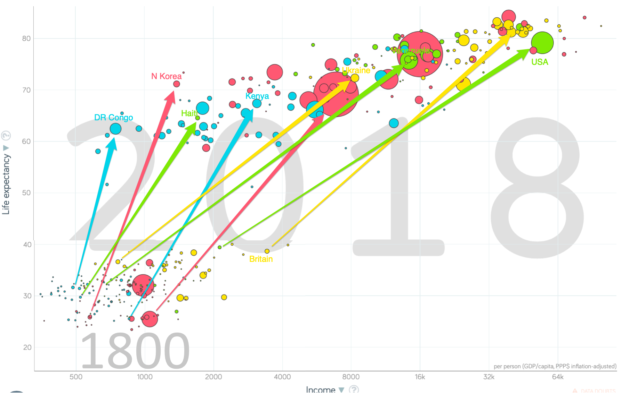
One Figure: A Great Divergence
From 1800 to 2018:
The dots start with a 3-1 spread in incomes and a 10-year spread in life expectancy.
All the arrows go up.
Some arrows—mostly those already to the right—go right fast.
Other arrows go right slowly.

Slide 21
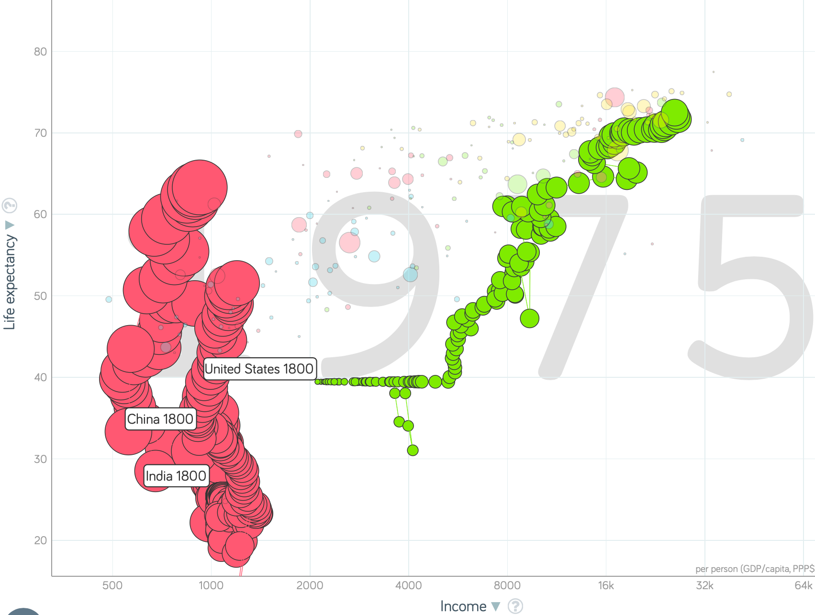
China and India and America, 1800-1975
From 1800 to 1975:
Measured living standards and productivity levels improve fourteen-fold in the United States…
…& less than 30% in China & India…
…in spite of economic, transport, and cultural globalization…
This is crazy!
A “great divergence”
Not only were China & India relatively poor in 1800, they fell further behind thereafter

Slide 22

China and India and America, 1975–2018
From 1975-2018:
Measured living standards and productivity levels…
…54.9/25.9 = 2.12 in America…
…16.0/0.9 = 17.8 in China… 6.6%/year
…6.9/1.2 = 5.8 in India… 4.2%/year

Slide 23
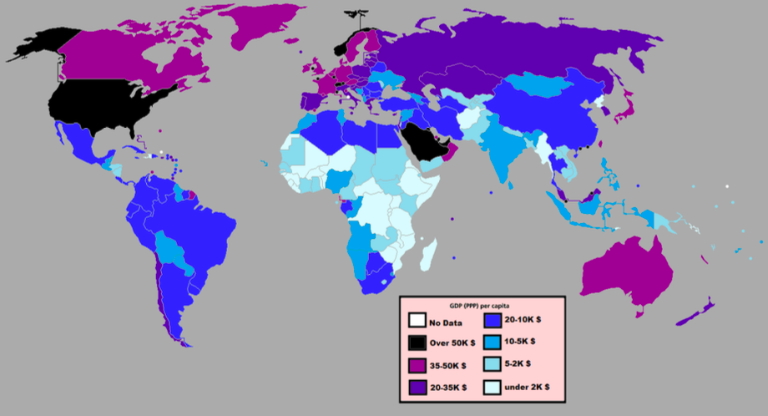
National Income Per Capita in 2012
Slide taken from Melissa Dell

Slide 24
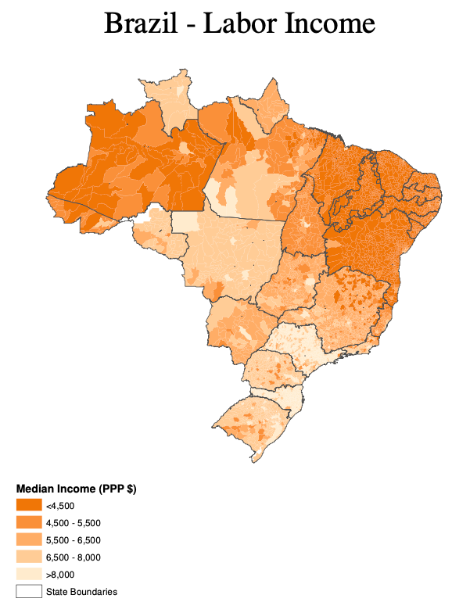
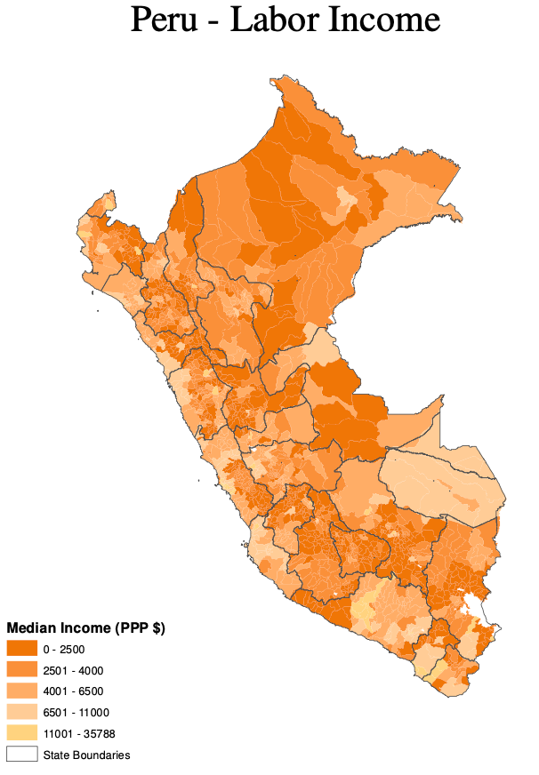
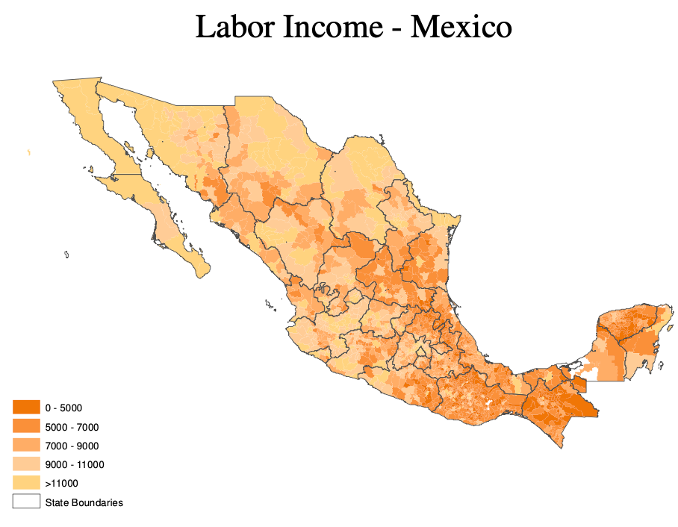
Subnational Inequality
Inequality across regions within countries is also high
In Latin America, inequality across regions within countries is twice as high as inequality across countries (Acemoglu and Dell, 2010)
About half of the differences can be statistically explained by observed human capital
Differences also highly correlated with geography
Slide taken from Melissa Dell

Slide 25
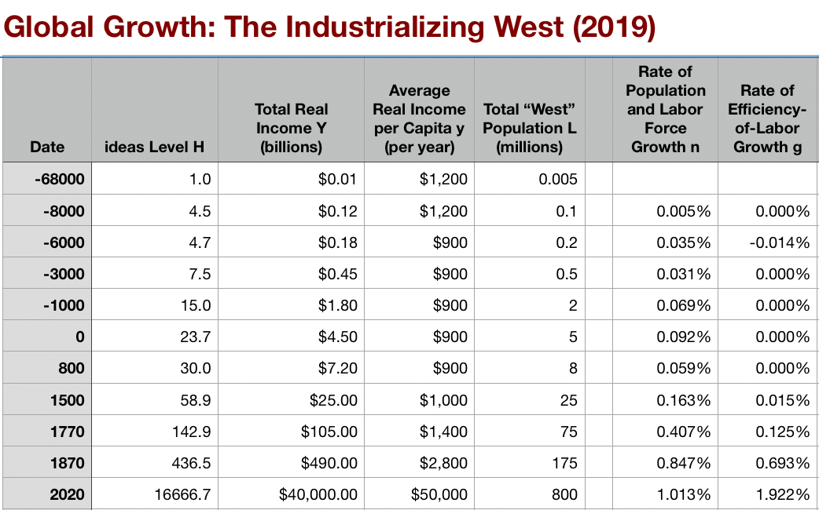
A Second Table: “The West”

Slide 26
About the Course
This course examines the history of economic growth, beginning when we became “us” and continuing as far as we get. Topics covered include:
human sociability;
the discovery of agriculture and the domestication of animals in the Neolithic Revolution
economic growth in ancient, Malthusian societies
the origins and maintenance of gross inequality
the Commercial and Industrial Revolutions
modern economic growth
theories and evidence about the institutional, geographic, and cultural determinants of growth: international prosperity differentials and the so-calledl "middle income trap"
OECD convergence and East Asian miracles
the political economy of growth and stagnation
the stubborn persistence of poverty

Slide 27
Administrivia
Assessment: Students are graded on the basis of:
fifteen assignments (45 points; 3 each),
a midterm (15 points),
in-class clicker-based quizzes and exercises (10 points),
section exercises and participation (10 points), and
a final (30 points)
LECTURE: TTh 09:40-11:00 Birge 50; FIRST LECTURE Jan 21
SECTIONS:
104 DIS W 08:10 Etcheverry 3119;
102 DIS W 10:10 VLSB 2070;
106 DIS Th 14:10 Dwinelle 179;
105 DIS Th 17:10 pm LeConte 385;
103 DIS M 08:10 Etcheverry 3119;
101 DIS M 10:10 VLSB 2070
COURSE WEBSITE: https://bcourses.berkeley.edu/courses/1487685
OFFICE HOURS: TBD…
Schedule:
T Jan 21: Growth in Historical Perspective, Humans and Their Economies
Th Jan 23: Robert Solow's Growth Model
T Jan 28: Malthusian Perspectives
Th Jan 30: Determinants of Progress in Technology and Organization
T Feb 4: Malthusian Agricultural Economies
Th Feb 6: Civilizational "Efflorescences" and Imperial Declines
T Feb 11: Why Was Pre-Industrial Progress so Slow on Average?
Th Feb 13: Commercial Revolutions
T Feb 18: The Industrial Revolution
Th Feb 20: Why Northwest Europe?
T Feb 25: EARLY MIDTERM (Instructor Reality Check)
Th Feb 27: Modern Economic Growth
T Mar 3: U.S. Economic Ascendancy
Th Mar 5: Globalization Advances and Retreats
T Mar 10: Convergence and Its Absence
Th Mar 12: Inequality and Plutocracy
T Mar 17: The Development of Underdevelopment
Th Mar 19: Western Europe, North America, and South America
T Mar 31: Behind the Iron Curtain, and East Asian Miracles
Th Apr 2: Asia and Africa
T Apr 7: "Deep Roots" vs. Path Dependence
Th Apr 9: Growth and Fluctuations; Trade and Development, Foreign Aid
T Apr 14: Plutocracy, Kleptocracy, & Neo-Fascism
Th Apr 16: Global Warming
T Apr 21: The Pace and Meaning of Economic Growth
Th Apr 23: The Future?
T Apr 28: Conclusion
Th Apr 30: Final Review
W May 13 11:30-14:30: FINAL EXAM

Slide 28
Before the Course Begins…
Do all of the below by ___:
Buy your books
Robert C. Allen (2011): Global Economic History: A Very Short Introduction https://books.google.com/?isbn=0199596654 (HC51 .A56 2011)
Robert C. Allen (2017): The Industrial Revolution: A Very Short Introduction https://books.google.com/?isbn=9780198706786 (HC254.5 .A664 2017)
Christopher J. Berry (2019): Adam Smith: A Very Short Introduction https://books.google.com/?isbn=0198784457 (B1545.Z7 B47 2018)
Partha Dasgupta (2007): Economics: A Very Short Introduction https://books.google.com/?isbn=9780192853455 (HB171 .D26 2007)
Buy and register your iClicker; bring it to class the first day
Do Assignment 1
Assignment 1:
Read the syllabus at:
Using the information in the syllabus, think up a question that should be on the FAQ—the Frequently Asked Question—list for the course
Answer the question you thought up
Upload your question and answer to your account at the course on canvas at: <https://bcourses.berkeley.edu/courses/1487685>

Slide 29
Four Major Features of the History of Economic Growth
The history of economic growth has four major features:
Poverty, in the pre-industrial ages; very slow growth in “technology” and in population
Exploding prosperity, in the Industrial Revolution 1770-1870 and the Modern Economic Growth 1870-today ages
The “Great Divergence” post-1800
Globalization
Chinese and Indian miracles since 1975
American twentieth-century economic ascendancy
Pre-industrial efflorescences and declines…

Slide 30
Catch Our Breath…
Ask a couple of questions?
Make a couple of comments?
Any more readings to recommend?
<>

Slide 31
Notes:
Julka Kuzmanovic-Cvetkovic: Neolithic Vinca was a Metallurgical Culture <https://www.stonepages.com/news/archives/002605.html>: 'The unnamed tribe who lived between 5400 and 4700 BCE in the 120-hectare site at what is now Plocnik knew about trade, handcrafts, art and metallurgy. Near the settlement, a thermal well might be evidence of Europe’s oldest spa. "They pursued beauty and produced 60 different forms of wonderful pottery and figurines, not only to represent deities, but also out of pure enjoyment," said Kuzmanovic. The findings suggest an advanced division of labor and organization. Houses had stoves, there were special holes for trash, and the dead were buried in a tidy necropolis. People slept on woollen mats and fur, made clothes of wool, flax and leather, and kept animals. The community was especially fond of children. Artefacts include toys such as animals and rattles of clay, and small, clumsily crafted pots apparently made by children at playtime. One of the most exciting finds for archaeologists was the discovery of a sophisticated metal workshop with a furnace and tools including a copper chisel and a two-headed hammer and axe. "This might prove that the Copper Age started in Europe at least 500 years earlier than we thought," Kuzmanovic said...
History.com: Bronze Age <https://www.history.com/topics/pre-history/bronze-age>: 'Sumer: By the fourth millennium BCE, Sumerians had established roughly a dozen city-states throughout ancient Mesopotamia, including Eridu and Uruk in what is now southern Iraq. Sumerians called themselves the Sag-giga, the “black-headed ones.” They were among the first to use bronze. They also pioneered the use of levees and canals for irrigation. Sumerians invented cuneiform script, one of the earliest forms of writing, and built large stepped pyramid temples called ziggurats. Sumerians celebrated art and literature. The 3,000-line poem “Epic of Gilgamesh” follows the adventures of a Sumerian king as he battles a forest monster and quests after the secrets of eternal life...

Slide 32
Notes:
Terence Bell: The Ancient History of Copper <https://www.thebalance.com/copper-history-pt-i-2340112>: 'Although various copper tools and decorative items dating back as early as 9000 BC have been discovered, archaeological evidence suggests that it was the early Mesopotamians who, around 5000 to 6000 years ago, were the first to fully harness the ability to extract and work with copper. Lacking modern knowledge of metallurgy, early societies, including the Mesopotamians, Egyptians, and Native Americans, prized the metal mostly for its aesthetic qualities, using it like gold and silver for producing decorative items and ornaments. The earliest organized production and use of copper in different societies have been roughly dated as: Mesopotamia, circa 4500 BC; Egypt, circa 3500 BC; China, circa 2800 BC.... Researchers now believe that copper came of regular use for a period—referred to as the Copper Age—prior to its substitution by bronze. The substitution of copper for bronze occurred between 3500 to 2500 BC in West Asia and Europe, ushering in the Bronze Age...
David W. Anthony (2007): The Horse, the Wheel, and Language: How Bronze-Age Riders from the Eurasian Steppes Shaped the Modern World <>

Slide 33
Notes III:
Stephen Mitchell, trans.: Gilgamesh, selections <https://www.bradford-delong.com/2020/01/anonymous-_the-man-who-saw-the-deep-gilgamesh_-surpassing-all-kings-powerful-and-tall-beyond-all-others-violent.html>: 'Surpassing all kings, powerful and tall beyond all others, violent, splendid, a wild bull of a man, unvanquished leader, hero in the front lines, beloved by his soldiers.... Who is like Gilgamesh? What other king has inspired such awe? Who else can say, “I alone rule, supreme among mankind”? The goddess Aruru, mother of creation, had designed his body, had made him the strongest of men—huge, handsome, radiant, perfect. The city is his possession, he struts through it, arrogant, his head raised high, trampling its citizens like a wild bull. He is king, he does whatever he wants, takes the son from his father and crushes him, takes the girl from her mother and uses her, the warrior’s daughter, the young man’s bride, he uses her, no one dares to oppose him. But the people of Uruk cried out to heaven, and their lamentation was heard, the gods are not unfeeling, their hearts were touched, they went to Anu, father of them all, protector of the realm of sacred Uruk, and spoke to him on the people’s behalf: “Heavenly Father, Gilgamesh—noble as he is, splendid as he is—has exceeded all bounds. The people suffer from his tyranny, the people cry out that he takes the son from his father and crushes him, takes the girl from her mother and uses her, the warrior’s daughter, the young man’s bride, he uses her, no one dares to oppose him. Is this how you want your king to rule? Should a shepherd savage his own flock? Father, do something, quickly, before the people overwhelm heaven with their heartrending cries.” Anu heard them, he nodded his head, then to the goddess, mother of creation, he called...

